Slide 1
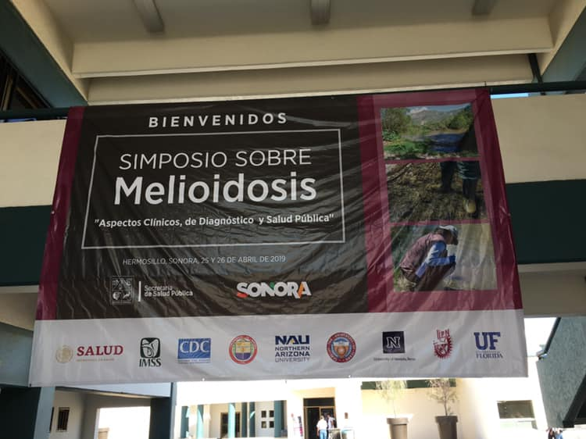
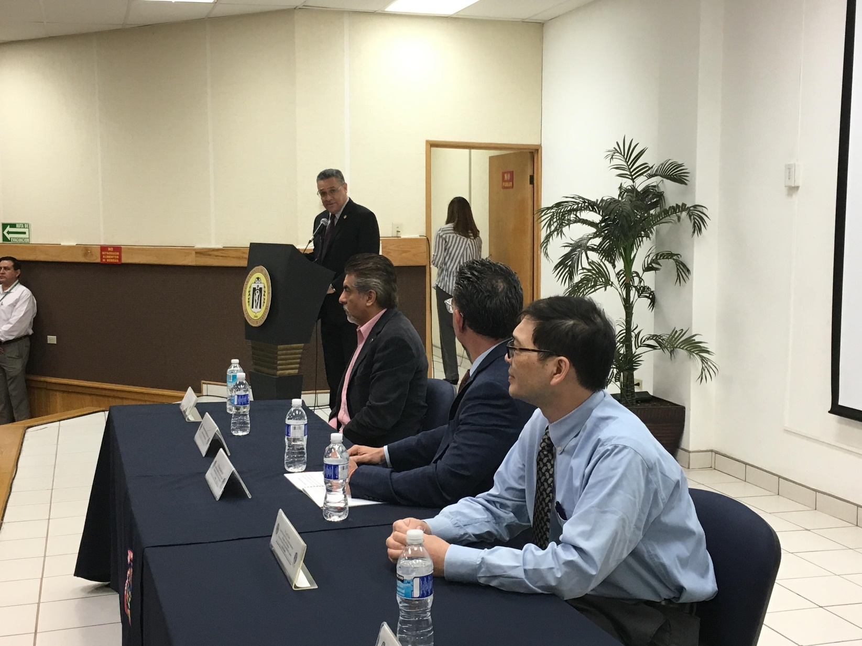
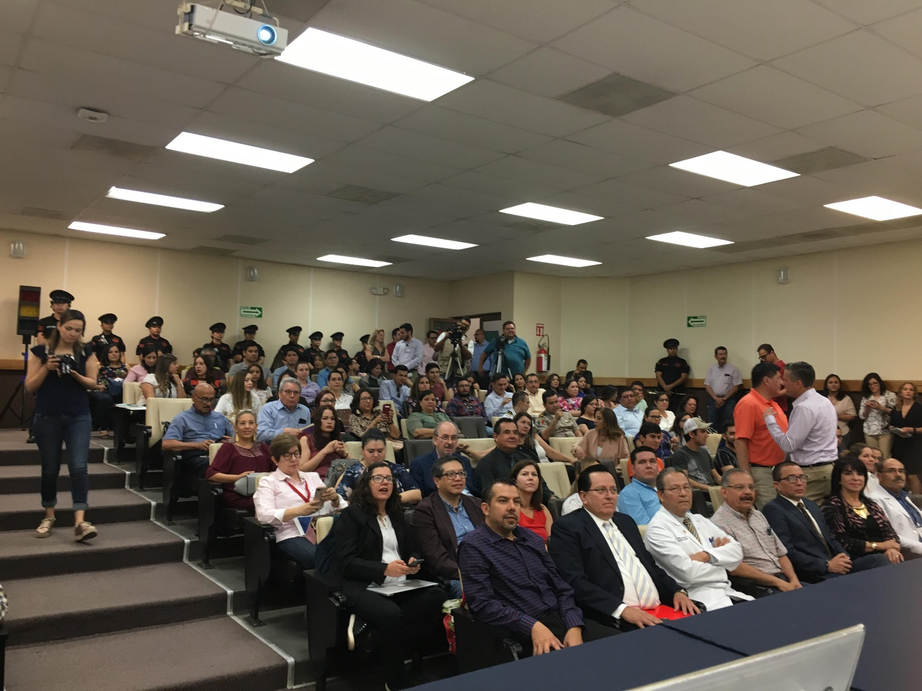
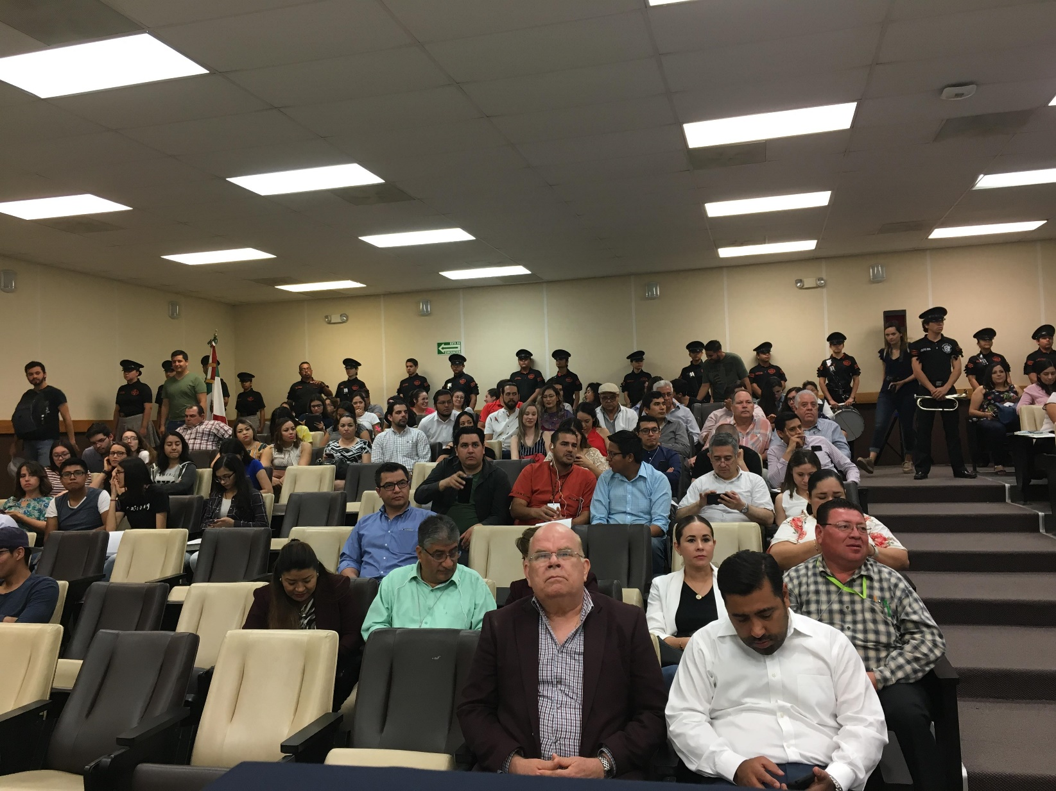
Opening ceremony of the Mexican Melioidosis Symposium, Hermosillo, Sonora, April 25-26, 2019

Slide 2
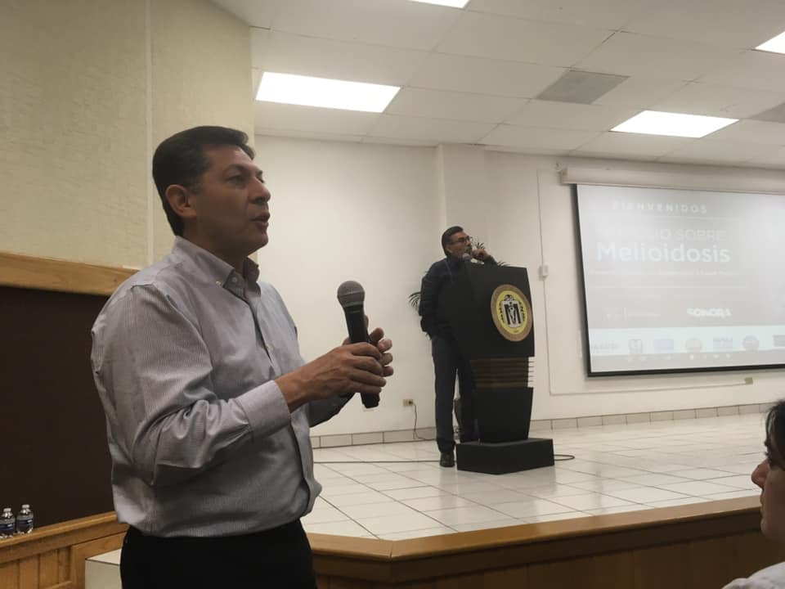
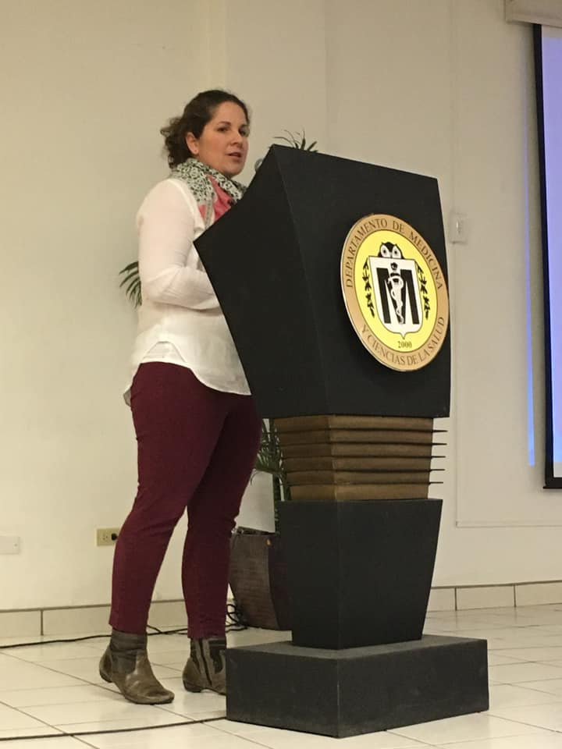
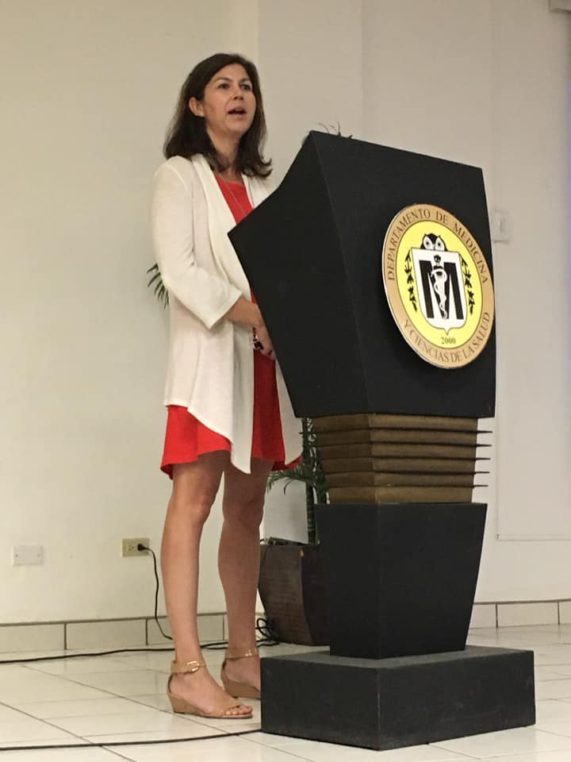
Dr Mindy Elrod
Dr Alfredo Torres and Dr Gerardo Alvarez
Dr Johanna Salzer

Slide 3
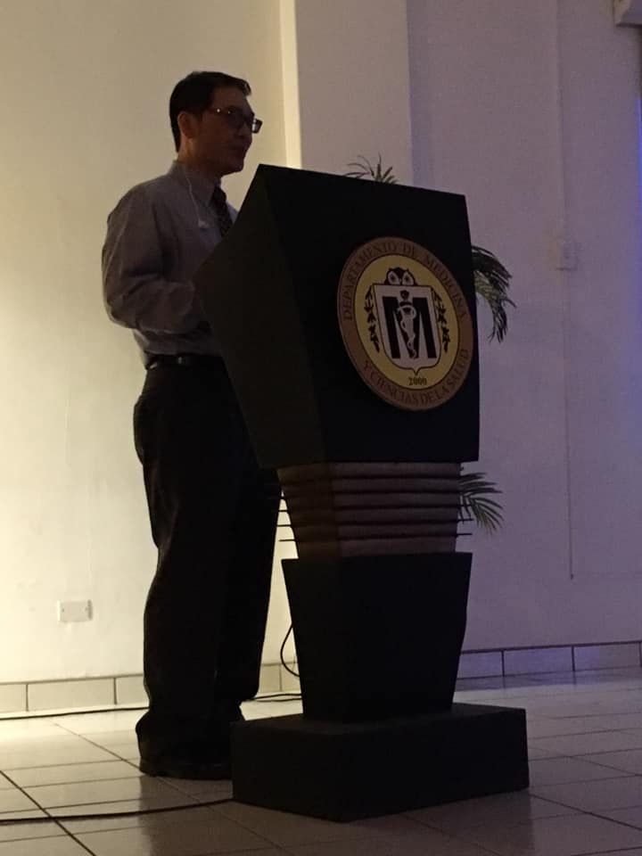
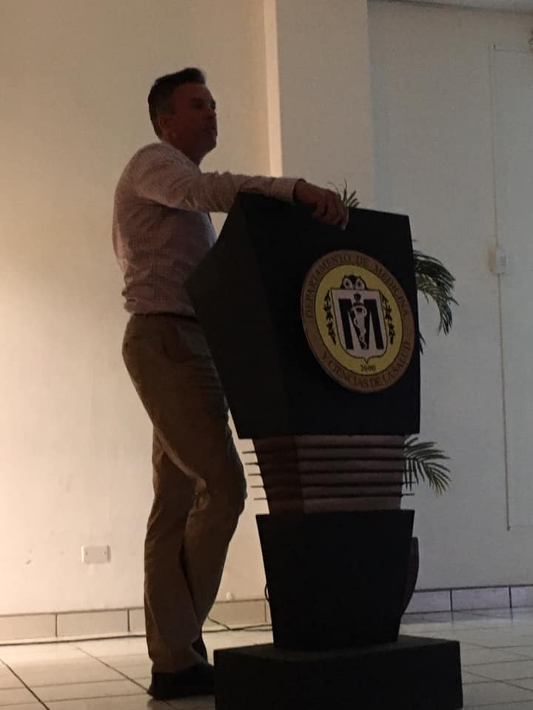
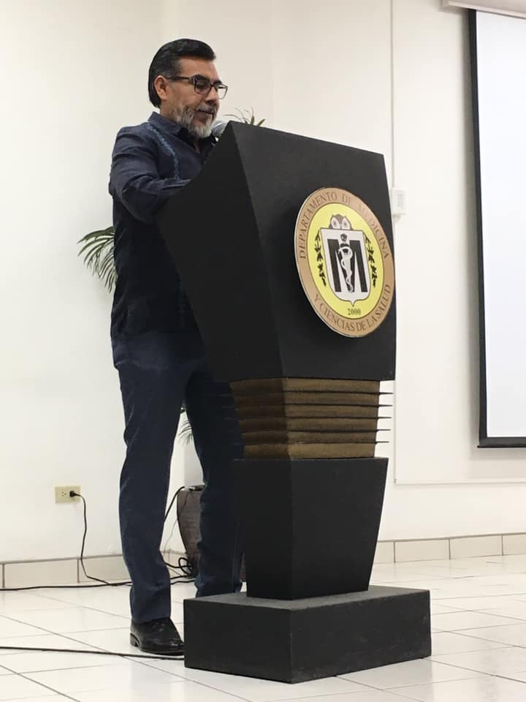
Dr Jay Gee
Dr David AuCoin
Dr Gerardo Alvarez

Slide 4
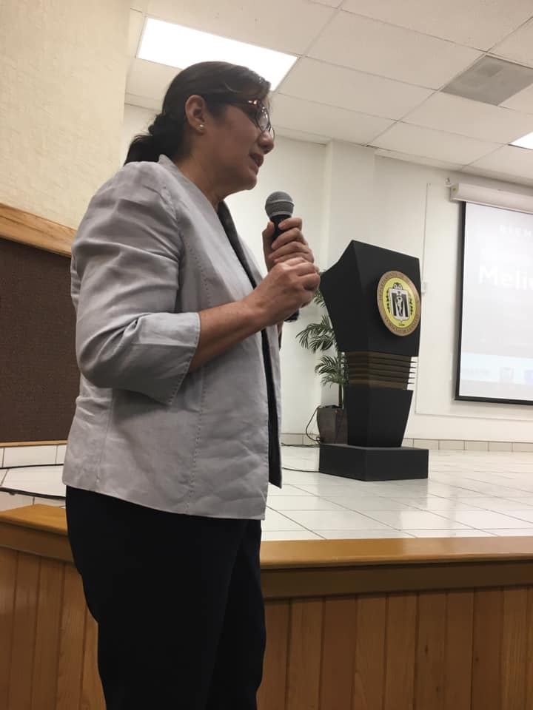
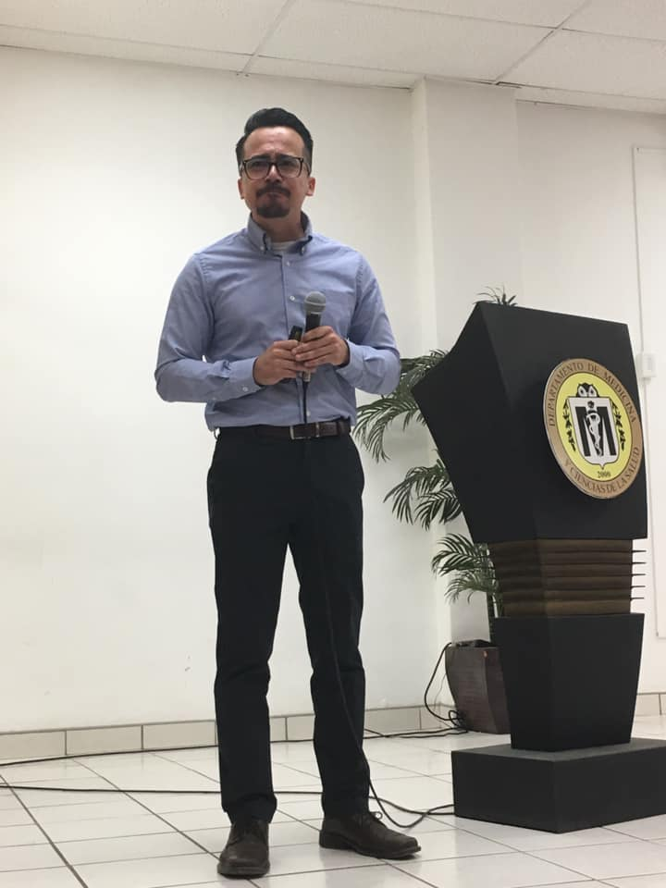
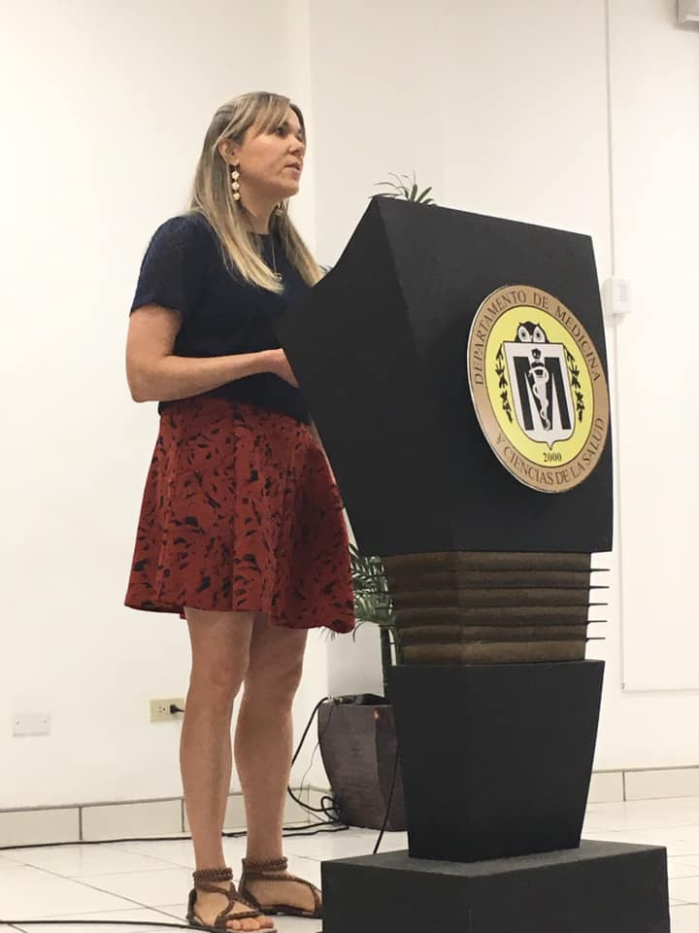
Dr Adela Rascon
Dr Carlos Boroel
Carina Hall

Slide 5
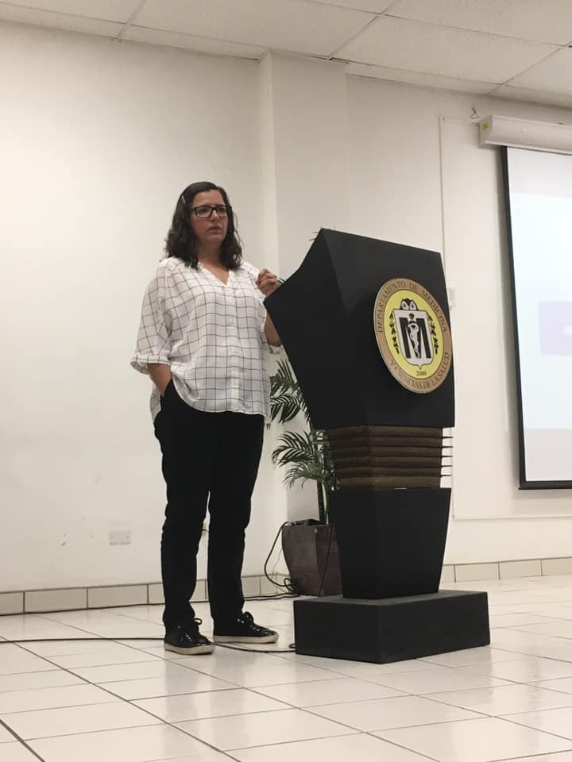
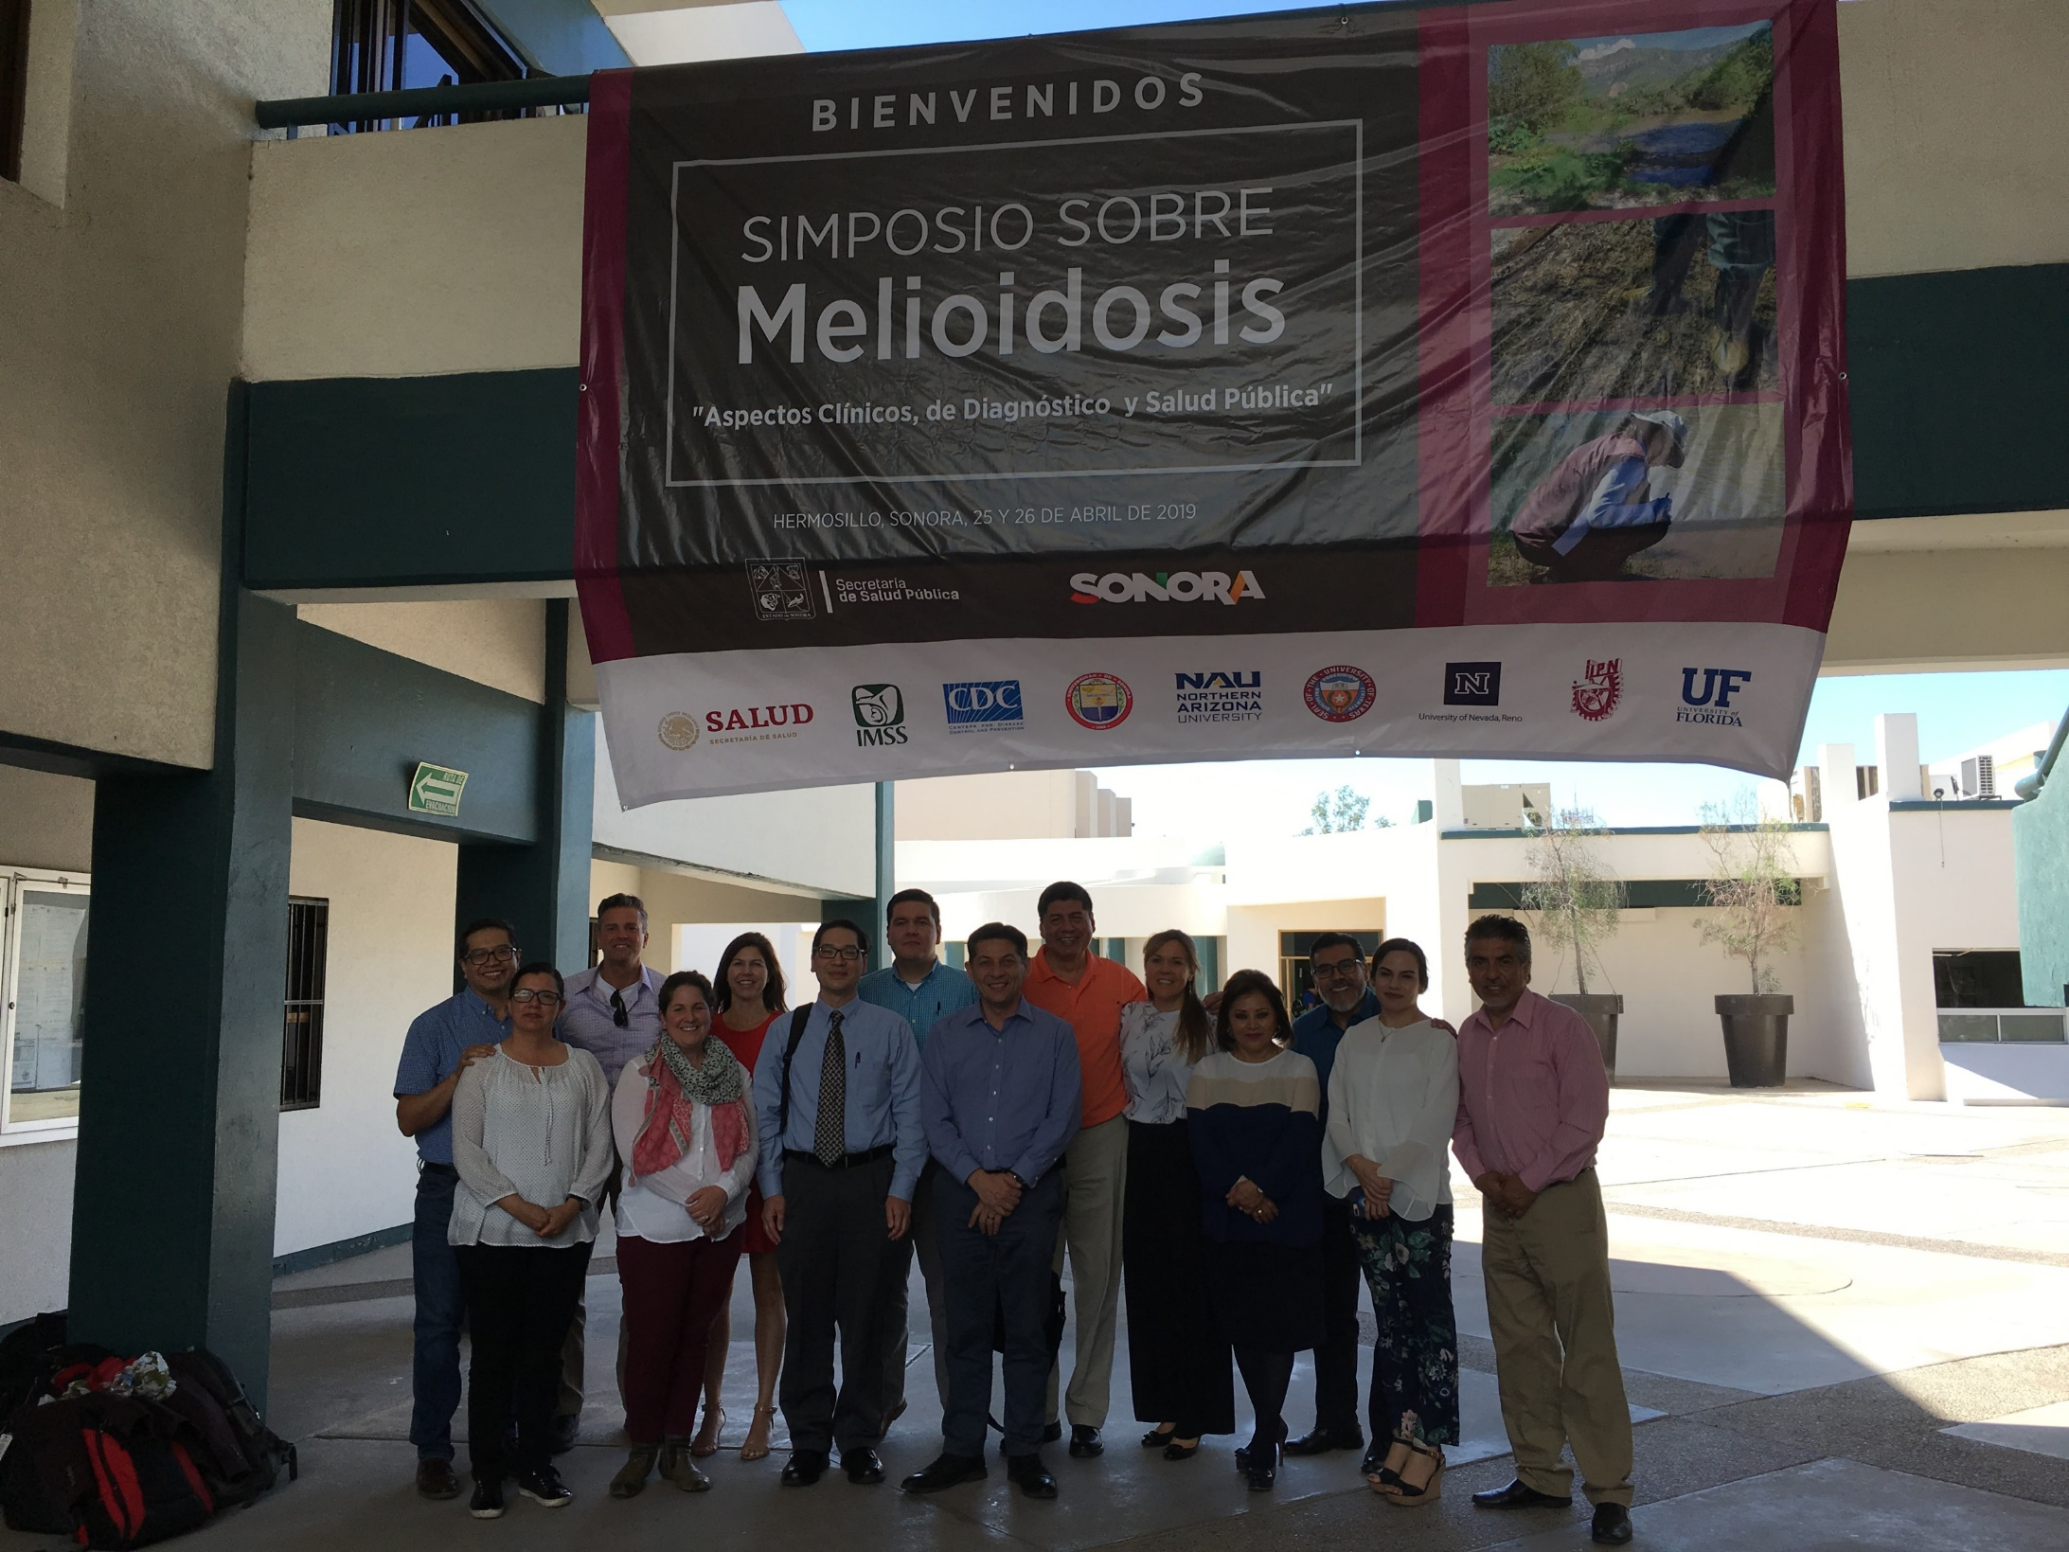
Dr Paulina Estrada
Speakers, Organizing Committee and guests of the Mexican Melioidosis Symposium

